Slide 1

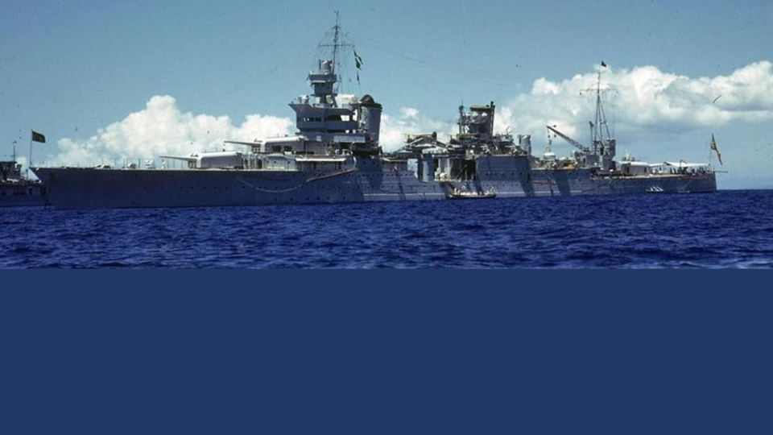
The Story of USS Indianapolis
An official presentation created by Carl Fahnestock
USS Indianapolis CA-35 Legacy Organization
Copyright © 2020
Notes:
1

Slide 2
This is a “Self-Study” learning module!
Progress through this module at your own pace by ….
Clicking the Mouse
or
Using the Page “Up/Down” buttons

Slide 3
The Story of USS Indianapolis
“The life and times of a ship and her crew
that served with honor in World War Two”

Slide 4
Was there more than one
United States Navy ship that was named
USS Indianapolis?

Slide 5

1. USS Indianapolis (ID 3865)
A Cargo Ship
(In commission from 12/12/1918 to 7/9/1919)
2. USS Indianapolis (CA-35)
A Cruiser Ship
(In commission from 11/15/1932 to 7/30/1945)
3. USS Indianapolis (SSN-697)
A Submarine
(In commission from 1/5/1980 to 12/22/1998)
4. USS Indianapolis (LCS-17)
A Combat Ship
(Commissioned on 10/26/2019)
Since 1918,
four US Navy Ships were commissioned using the name
“USS Indianapolis”
We will learn about this ship!

Slide 6

USS Indianapolis (CA-35)
USS Indianapolis (CA-35) was a Portland Class Cruiser Ship that was commissioned by the United States Navy on 15 Nov 1932.
Her nickname was: INDY
INDY was commissioned just one week after Franklin Delano Roosevelt’s (FDR’s) successful win in the 1932 US Presidential Election.
Let’s consider the reasons why this newly elected President of the United States would establish an affection for
USS Indianapolis (CA-35) …

Slide 7
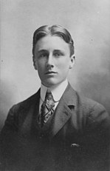
Franklin Delano Roosevelt’s Early Years
At an early age, FDR learned sailing.
At age 16, his father gifted him a sailboat.
Here is a photo of future President Franklin Delano Roosevelt in 1900 at the age of 18 …….

Slide 8
Lifelong Affection for the Navy
History has recorded that FDR developed a
“Lifelong Affection for the Navy”
It is also recorded that, by age 31, FDR had already collected almost 10,000 Naval Books and he claimed to have read “all but one.”

Slide 9
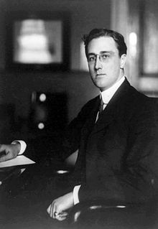
Assistant Secretary of the Navy
As a young man in his thirties, FDR was appointed by President Woodrow Wilson to serve the United States as the
Assistant Secretary of the Navy
He served in this role from 1913-1919.
Here is a photo of FDR as he assumed this important United States Navy position in 1913 at the ripe young age of 31 ……

Slide 10
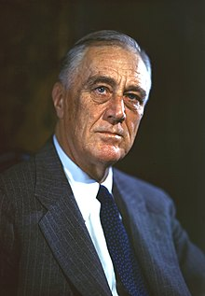
32nd President of the United States
As we learned earlier, FDR’s political career ultimately led to his election in 1932 as the
32nd President of the United States
Here is a photo of FDR which was taken during his tenure as President ……….

Slide 11
FDR’s “Ship of State”
Perhaps FDR’s aforementioned “Lifelong Affection for the Navy,” in conjunction with the timing of his election win (just one week prior to the cruiser’s commissioning), were the key factors in his decision to select USS Indianapolis (CA-35) as his
“Ship of State”

Slide 12
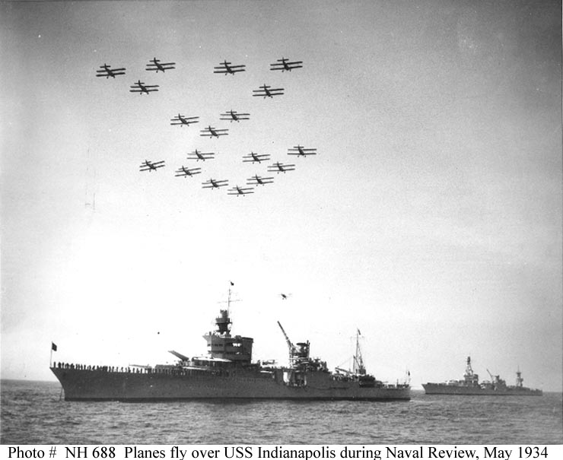
FDR’s “Presidential Naval Reviews”
FDR also selected INDY to serve as a host ship for his review of selected air and naval forces of the United States Navy.

Slide 13
FDR’s “Key Cruises on Indy”
Throughout FDR’s presidency, he often selected USS Indianapolis (CA-35) to host multiple Presidential Cruises for himself and his guests.
Most notably, these cruises included:
1933 - Panama Canal transition
1934 - Embarked FDR to Brazil, Argentina & Uruguay
1936 - South American “Good Neighbor” Tour
Crossing the Line Ceremony

Slide 14
Indy was an “Elegant Ship”
USS Indianapolis (CA-35) was a fast, sleek and beautiful ship that could proudly carry the President of the United States and his guests anywhere with understated elegance.
She had a beautiful polished teak wood deck area on the quarterdeck (great for dancing and special events) and her rails were often decorated with Japanese lantern lights.
But, she was more than just an Elegant Ship ……..
Notes:
14

Slide 15
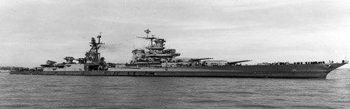

Indy was a “Warship”
Powerful offensive armory
A long range of travel
Speed to outrun enemy submarines

Slide 16

“A Picture is Worth a Thousand Words”
No. 3 gun turret
Personnel Complement
1,195
No. 2 gun turret
No. 1 gun turret
Overall Length 610 ft
$10,903,200 Cost
10,110 Ton Displacement
Design Speed of 32 Knots
Range of 10,000 Nautical Miles
The above data represents the final configuration of the ship just prior to the end of WWII
Notes:
16

Slide 17

Indy’s Peacetime Service
During the first nine years of Indy’s service as a US Naval vessel
(Nov 1932 thru Nov 1941), she served during a time of peace.
Her service was exemplary and she was selected to serve as the
”Flagship” for the Commander of Scouting Force 1.
She served in this role for eight years.
Serving as a flagship was indeed an honor given that an admiral would be assigned to live aboard the ship and command during selected periods of fleet maneuvers.
This peaceful time would end in December of 1941.

Slide 18
Pearl Harbor – 7 December 1941
The Imperial Japanese Navy (IJN) attacked the Naval Port at Pearl Harbor, Hawaii during the early Sunday morning hours of 7 December 1941.
This unprovoked attack prompted the United States of America to declare war on Japan.
The United States of America then joined with other Allied Countries to officially engage and participate in
World War Two (WW II)

Slide 19
Indy begins her WW II period of service
On 7 December 1941, Indy was not in Pearl Harbor.
She had been participating in a mock bombardment at Johnston Atoll (an uninhabited island located 750 nautical miles southwest of Hawaii).
That day, she joined Task Force 12 to search the area for Japanese ships but their combined search proved unsuccessful.
Indy then sailed to Pearl Harbor and on 13 December she joined Task Force 11 to officially begin her WW II period of service.

Slide 20
Indy served as a “Flagship” in WWII
From February 1942 thru March 1945, Indy actively participated in multiple campaigns and battles throughout the Pacific as a member ship under the overall command of CINCPAC (Commander in Chief, Pacific) Admiral Chester Nimitz.
In November 1943, she was selected to serve as a CINCPAC
“Flagship”
for
Admiral Raymond A. Spruance*
* Admiral Spruance used Indy as his flagship as Commander of the Central Pacific Force and the Fifth
Fleet from November 1943 thru March 1945.

Slide 21
Battle Stars
During WW II, many US Navy Warships earned Battle Stars.
Battle Stars (also known as “Commendations”) were issued to US Navy Warships in recognition of their meritorious participation in battle or for having suffered damage during battle conditions.
In honor and recognition of her valiant service in WW II, Indy ultimately earned a total of Ten (10) Battle Stars.
Let’s take a look at each of Indy’s Ten (10) Battle Stars!

Slide 22

1st Battle Star
Bougainville Air Action and Salamaua-Lae Raid
20 February 1942 and 10 March 1942
Indy joined Task Force 12 and traveled to South Pacific to escort the aircraft carrier Lexington. On 20 Feb, the ships in TF12 were attacked near Rabaul, New Britain by 18 Japanese aircraft. Of these, 16 were shot down by aircraft from the Lexington and Indy participated with her anti-aircraft armory and joined other TF12 ships in destroying the remaining 2 planes. On 10 Mar, Indy joined with the carrier Yorktown and other U.S. ships to attack Lae and Salamaua, New Guinea against Japanese amphibious forces that were marshaling there. Heavy damage was inflicted on Japanese warships and transports by the combined Task Force group.
1
2
3
4
5
6
7
8
9
10

Slide 23
2nd Battle Star
Aleutians Operation: Attu Occupation
25 May 1943 – 2 June 1943
Indy’s participation in the Aleutians Campaign actually began on 7 August 1942 when Indy and the Task Force attacked Kiska Island which was a Japanese staging area. Japanese shore batteries were destroyed by the Task Force Ship’s main guns. Months later, on 19 February 1943, Indy led two destroyers on a patrol of Attu Island and sank a 3,150 ton Japanese cargo ship (Akagane Maru) laden with troops, munitions and supplies). Through mid-1943, Indy remained near the Aleutian Islands and escorted American convoys and provided shore bombardments which supported amphibious assaults. In May, the Allies captured Attu.
2
1
3
4
5
6
7
8
9
10

Slide 24
3rd Battle Star
Gilbert Islands Operation
20 November 1943 – 8 December 1943
After receiving service and refit at the Mare Island naval Shipyard in San Francisco, Indy moved to Hawaii and was selected as the flagship of Admiral Spruance who commanded the 5th Fleet. She left Hawaii on 10 November to participate in Operation Galvanic (the invasion of the Gilbert Islands). On 19 November, Indy bombarded Tarawa Atoll and the next day pounded Makin. She then returned to Tarawa to provide fire-support for the landings. Her guns shot down an enemy plane and shelled enemy strongpoints as landing parties fought Japanese defenders in the Battle of Tarawa. She continued this role until the island was secured three days later.
3
1
2
4
5
6
7
8
9
10

Slide 25
4th Battle Star
Marshall Islands Operation:
Occupation of Kwajalein and Majuro Atolls
And Occupation of Eniwetok Atoll
29 January 1944 – 8 February 1944
17 February 1944 – 2 March 1944
Indy met other ships of her task force at Tarawa, and on D-Day minus 1 (31 January 1944), she joined other cruisers to bombard the islands of Kwajalein Atoll. Shelling continued on D-Day, with Indy suppressing two enemy shore batteries. The next day, Indy destroyed a blockhouse and other shore installations and supported advancing troops with a “Creeping Barrage” (shelling moved forward slowly at about 100 yards every few minutes to keep pace with the infantry).
4
1
2
3
5
6
7
8
9
10

Slide 26
5th Battle Star
Asiatic-Pacific Raids:
Palau, Yap, Ulitihi and Woleai Raid
30 March 1944 – 1 April 1944
Indy, as the Flagship of the 5th Fleet, led in participating in multiple attacks in the Western Carolines (Palau, Yap, Ulithi and Woleai islands). On 30-31 March, carrier planes at Palau sank three destroyers, 17 freighters and five oilers and damaged 17 other ships. On 31 March, Yap and Ulithi were struck by the 5th Fleet Task Force with Indy serving as the Flagship. The strike continued at Woleai on 1 April. Indianapolis shot down a torpedo bomber and the Japanese lost 160 planes, including 46 on the ground. These attacks by Indy and the 5th Fleet were very important in that they prevented Japanese forces stationed in the Carolines from interfering with the US landings on New Guinea.
5
1
2
3
4
6
7
8
9
10

Slide 27
6th Battle Star
Marianas Operation:
Capture/Occupation of Saipan and Guam
Battle of the Philippine Sea
11 June 1944 – 10 August 1944
In June, the 5th Fleet was busy with the assault on the Marian Islands. Raids on Saipan began with carrier-based planes on 11 June followed by surface bombardment, in which Indy had a major role. A combined US fleet fought the Japanese on 19 June in the Battle of the Philippine Sea. That day the US Navy destroyed a reported 426 Japanese planes while losing 29. Indianapolis shot down one torpedo plane. This day of aerial combat became known as the “Marianas Turkey Shoot”. With Japanese air opposition wiped out, the US carrier planes sank Hiyo, two destroyers, and one tanker and damaged others. Taiho and Shokaku (carriers) were sunk by submarines.
6
1
2
3
4
5
7
8
9
10

Slide 28
7th Battle Star
Capture/Occupation of Tinian Island
24-25 July 1944
Indy returned to Saipan on 23 June to resume fire support and later moved to Tinian to attack shore installations. Meanwhile, Guam had been taken and Indy became the first ship to enter Apra Harbor since early in the war.
7
1
2
3
4
5
6
8
9
10

Slide 29
8th Battle Star
Western Caroline Islands Operation:
Capture/Occupation of Southern Palau Islands
6 September 1944 – 14 October 1944
In early September, Indy moved to the Western Carolines, where further landings were planned. From 12 to 29 September, she bombarded Peleliu before and after the landings. She then sailed to Manus Island where she operated for 10 days before returning to the Mare Island Navy Shipyard in California for refitting.
8
1
2
3
4
5
6
7
9
10

Slide 30
9th Battle Star
Iwo Jima Operation:
Fifth Fleet Raids against Honshu and the Nansei Shoto
15 February 1945 – 6 March 1945
Overhauled, Indy joined Vice Admiral Marc A. Mitscher’s fast carrier task force on 14 February 1945. The task force raced to the Bonin Islands to support the landings on Iwo Jima. Indy remained there until 1 March, protecting the invasion ships and bombarding targets in support of the landings. American forces destroyed 158 planes and sank five small ships while Indy joined in pounding ground installations and destroying trains.
9
1
2
3
4
5
6
7
8
10

Slide 31
10th Battle Star
Okinawa Gunto Operation:
Fifth/Third Raids in Support of Okinawa Gunto
and Assault/Occupation of Okinawa Gunto
17-25 March 1945
and 26 March 1945 – 5 April 1945
Indy was assigned to Task Force 54 for the invasion of Okinawa. Beginning on 24 March, Indy spent 7 days pouring 8-inch shells into the beach defenses. During this time, enemy aircraft repeatedly attacked the American ships. Indy shot down six planes and damaged two others. On 31 March, Indy Lookouts spotted a Japanese Nakajima Ki-43 “Oscar” Fighter (a Kamikaze Plane). Indy’s 20 mm guns opened fire, but the pilot managed to release a bomb before crashing his plane on Indy’s fantail. The bomb traveled down through the ship and exploded at the bottom killing 9 sailors and injuring 26 others. Indy suffered physical damage and returned to Mare Island Naval Shipyard for dry-dock and repairs.
10
1
2
3
4
5
6
7
8
9

Slide 32
Kamikaze
As was just shared, It was a “Kamikaze” plane that created tragedy for Indy when she earned her 10th Battle Star in the Okinawa Gunto Operation.
In the latter days of WW II, the Imperial Japanese Navy (IJN), in desperation, resorted to extreme offensive tactics in the Pacific.
The tactics included the use of suicide pilots and planes.
Simply put, Japanese “Kamikaze“ pilots deliberately guided and crashed their planes into enemy ships to cause damage and hopefully sink them.

Slide 33
Tragic Events were recorded
As previously mentioned, Indy was the Flagship for Admiral Spruance.
Flag Staff Log Books are maintained to record the details of daily life and events aboard and around a Flagship.
Admiral Spruance’s Flag Staff Log Book includes detailed descriptions about all of the events that occurred onboard Indy and other Task Force ships and aircraft during the March to April 1945 Okinawa Gunto Operations.
Let’s take a look at the actual captivating Log Book entries which describe
(in horrific detail) the Kamikaze attack and tragedy that unfolded
aboard USS Indianapolis in Okinawa!

Slide 34
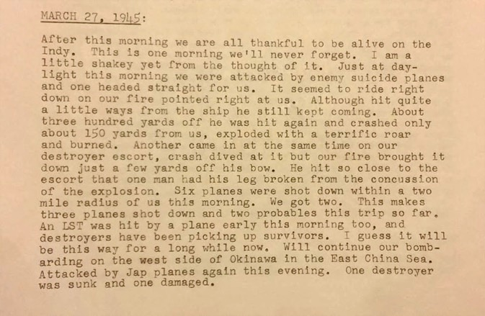
Admiral Spruance’s Flag Staff Log Book – Page 1

Slide 35
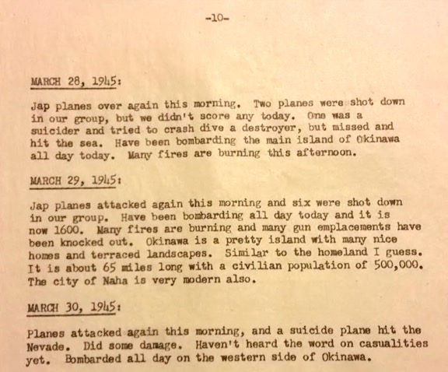
Admiral Spruance’s Flag Staff Log Book – Page 2

Slide 36
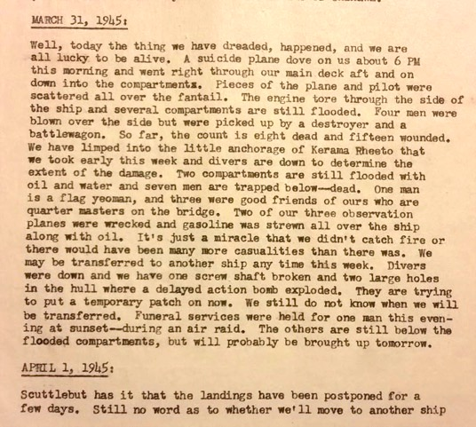
Admiral Spruance’s Flag Staff Log Book – Page 3

Slide 37
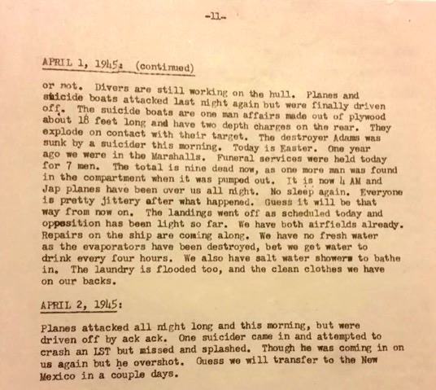
Admiral Spruance’s Flag Staff Log Book – Page 4

Slide 38
Admiral Spruance’s Flag Staff Log Book
Summary
In summary, Admiral Spruance’s Flag Staff Log Book recorded the details of the following events that occurred onboard Indy …..
Kamikaze plane dropped bomb and crashed onboard
Nine (9) crew members were killed
Twenty-Six (26) crew members were wounded
Severe damage was sustained on Indy

Slide 39
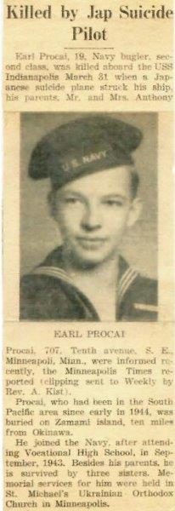
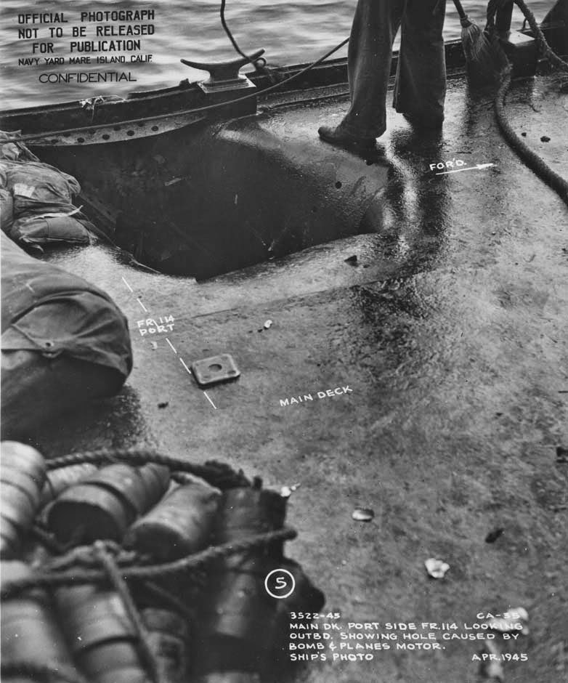
Damage at the portside fantail deck entry point where a 500 lb bomb from a Kamikaze plane penetrated and traveled down to a delayed explosion below Indy’s hull.
Obituary - 19 year old Bugler Earl Procai

Slide 40

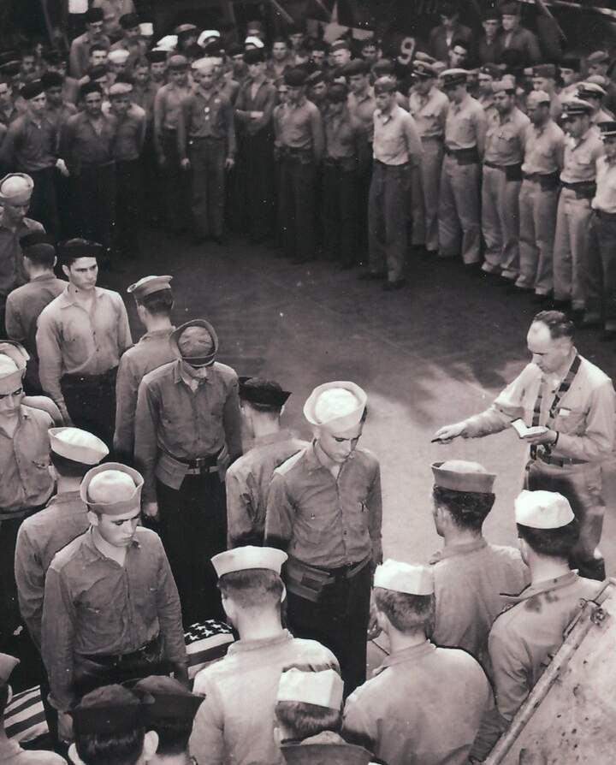
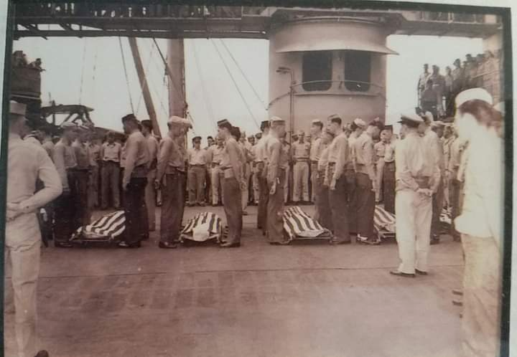
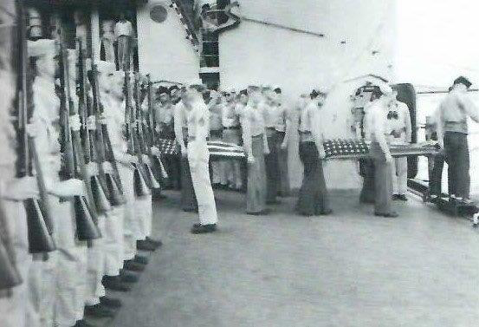
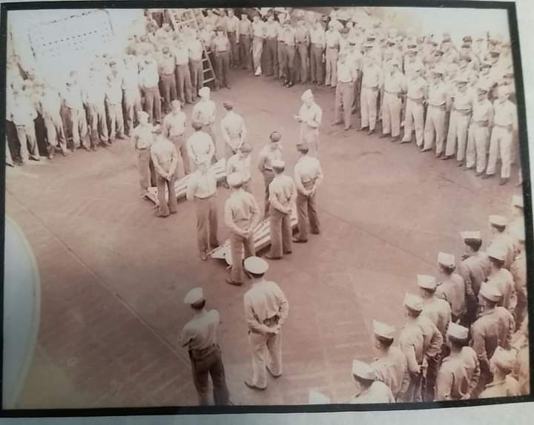
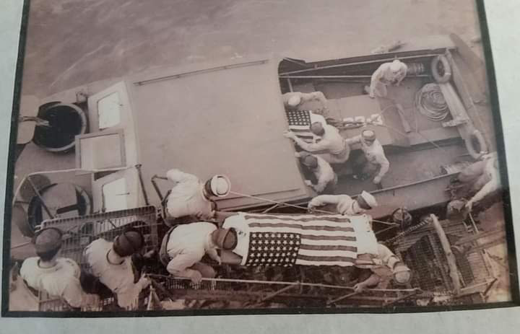
Burials at Sea

Slide 41
Major Repairs at Mare Island, CA
After receiving preliminary repairs in the South Pacific, Indy sailed under her own power to Mare Island in Vallejo, CA (35 miles north of San Francisco).
She arrived at Mare Island on 3 May 1945.
There, Indy entered dry dock for overhaul and repair of the combat damage she had suffered in the Okinawa Gunto Operation.
During the period of dry dock, many of her crew would take leave to return home to visit their families.
About 25% of her crew would turnover, and many new, younger crew members would come aboard during this period.

Slide 42

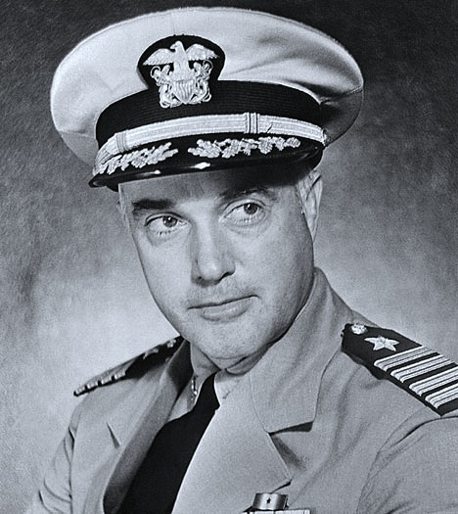
Captain Charles B. McVay, III
Over Indy’s 12+ years of consecutive service in the United States Naval Fleet, there were a total of ten U.S. Navy Captains who served in the role of Commanding Officer (CO) aboard USS Indianapolis (CA-35).
Captain Charles B. McVay, III was one of those men and he served as Indy’s CO (aka Skipper) during the last two campaigns in which Indy CA-35 earned her 9th and 10th Battle Stars.
Captain McVay would ultimately serve as the ship’s last CO.

Slide 43
A Special Assignment
Captain McVay retained his command of the ship throughout the Mare Island overhaul and repair.
On 12 July 1945 (just over 2 months after arriving at Mare Island), Captain McVay was informed that Indy had been selected for a Special Assignment.
He received orders that Indy was being scheduled to leave Mare Island on 16 July 1945 and would be transporting a
“Top Secret Cargo.”

Slide 44

Top Secret Cargo
On 15 July 1945, a large wooden crate (5 ft high x 5 ft wide x 15 ft long) was loaded by crane onto Indy’s main deck and was then transferred to the port hangar where armed marines were posted for guard duty around the clock.
Also, two metal canisters were hand carried from the dock up the ship’s brow and then on to the Flag Secretary’s quarters where they were chained to the deck with eye bolts. Two armed marines were then stationed at the quarter’s entrance to begin guard duty (24/7).
A ten day trip to Tinian Island would begin on 16 July 1945 and Indy’s arrival (to offload the cargo) was scheduled for 26 July 1945.

Slide 45

Hunter’s Point to Pearl Harbor to Tinian Island
On 16 July, Indy departed Hunter’s Point, CA .
Just 74.5 hours later, Indy arrived at Pearl Harbor for a brief stop to unload passengers and refuel.
The 2,091 mile voyage marked from Farallon Light, San Francisco (where Indy came out of the channel after leaving Hunter’s Point) to Diamond Head, Pearl Harbor, had set a new
US Navy Speed Record
After just a few hours in Pearl Harbor, Indy left port and was again underway for the remainder of her trip to Tinian Island.
Indy arrived on schedule at Tinian Island on 26 July where the
“Top Secret Cargo” was safely off-loaded.
We will learn about the contents of this cargo later in this presentation!

Slide 46
Tinian Island to Guam
After delivering the “Top Secret Cargo” at Tinian Island, Indy departed for a 120 mile overnight trip to Guam.
She arrived at Guam on 27 July where she was refueled and cargo and ammunition were loaded.
Captain McVay went ashore and met with Senior Staff to schedule details for her next voyage.
There, he received orders that Indy was to depart Guam on the morning of 28 July for an 1,100+ mile voyage to Leyte (Philippines).

Slide 47
Route Peddie Recommended
Captain McVay’s orders also included traversing the Philippine Sea from Guam to Leyte by following an almost directly westward route commonly referred to as
“Route Peddie.”
McVay traveled without an escort which was unusual for a ship the size of Indy.
He was advised that there was a low probability that he would encounter enemy ships, so “Route Peddie” was recommended.

Slide 48
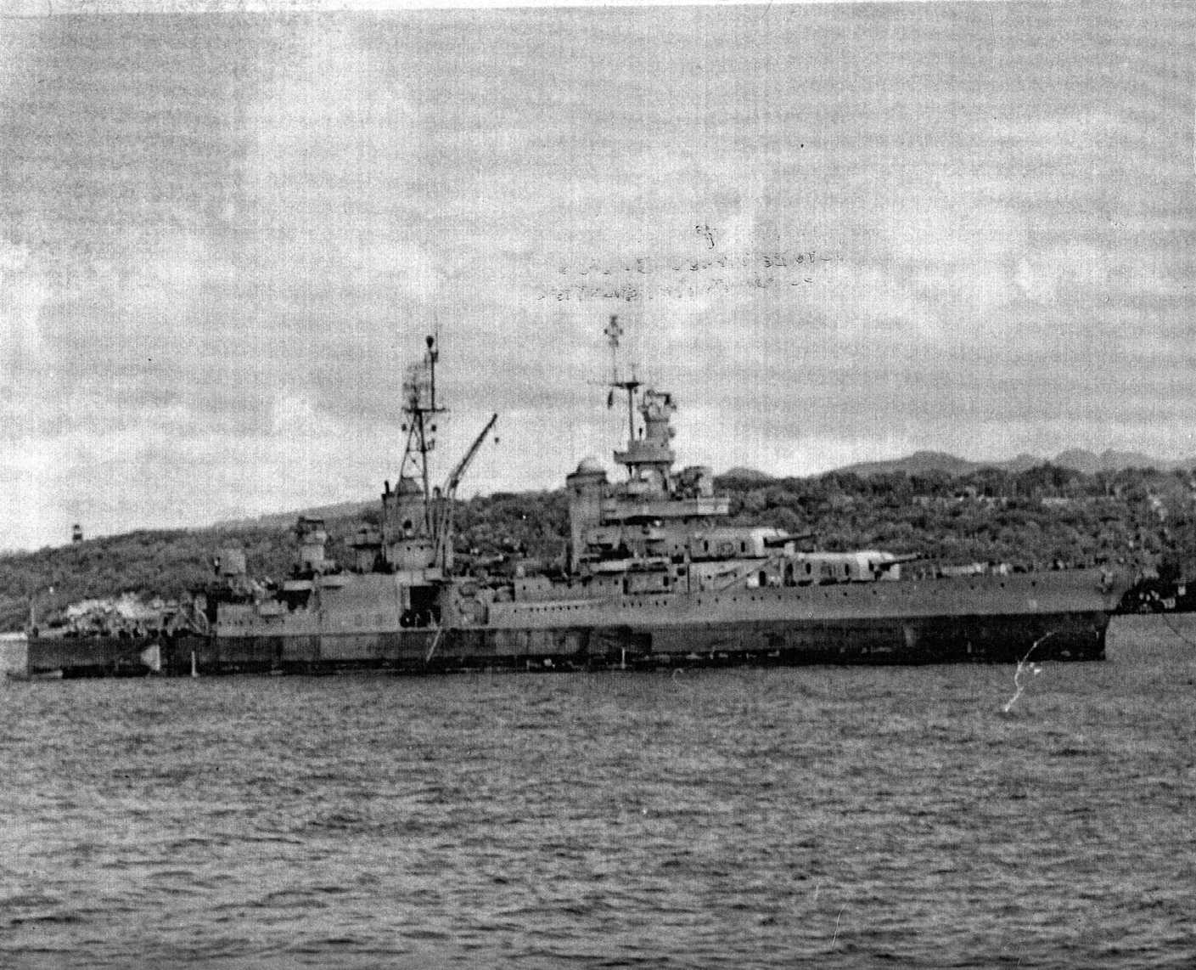
Here is an actual photo of Indy at Guam on 27 July 1945
(this photo is purported to be the last actual photo of Indy)
Photo by USS Pandemus
27 July 1945 at Guam

Slide 49
Training Exercises in Leyte
Captain McVay’s orders were to take Indy to Leyte to participate in training for his crew.
As previously mentioned, during the 2+ months of Indy’s Mare Island overhaul, about 25% of his crew had turned over and were replaced by younger and very inexperienced sailors (many of whom had never been to sea).
Once training was completed, Indy would then be prepared to join other forces and participate in an imminent “Invasion of Japan.”

Slide 50
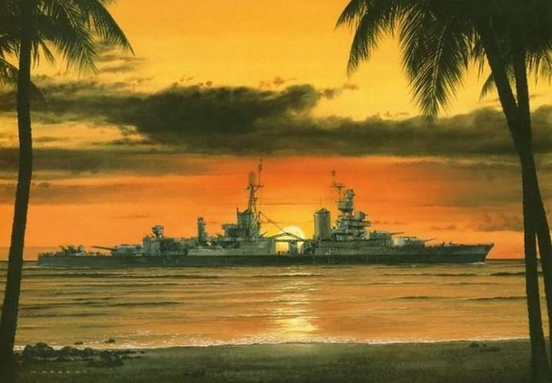
Here is a depiction of Indy silhouetted in a very “peaceful” sunset
(a view that could have been seen before Indy’s 28 July 1945 Guam departure)

Slide 51
Underway from Guam to Leyte
Captain McVay had negotiated that Indy would travel “Route Peddie” at an SOA (Speed of Advance) of 15.7 knots per hour in order to complete an arrival at Leyte on the morning of Tuesday, 31 July.
He was advised to “Zig Zag” the ship “At his discretion.”
Zigzagging was a defensive strategy in which the helmsman steered a ship back and forth at angles across the base course in order to throw off the calculations of enemy sub skippers attempting torpedo attacks.
Indy departed Guam at 0900 hrs on Saturday, 28 July 1945.

Slide 52
Out to Sea Routines
Many of the crew chose to sleep topside for a few hours (between their duty watches) during the darkness of the night of 28 July.
The evening air was sweltering hot (especially in confined sleeping compartments below deck), so Captain McVay invited the crew at their discretion to sleep out under the stars on the main deck.
The crew awoke on Sunday morning (29 July) in anticipation of enjoying a relaxing day onboard (church, meals, card games, etc.).
The only exception were the six 4 hour time periods throughout the 24 hour day when pre-assigned crew members would be fulfilling US Navy Duty Watch obligations (standard US Navy protocol).

Slide 53
US Navy Duty Watches
During WW II (and throughout subsequent years following WWII), standard US Navy Operating Procedures for large ships required ¼ of the crew (at any point in time during a 24 hour period) to be officially assigned Duty Watch obligations for each established 4 hour shift.
In the minutes of time just prior to the end of a defined 4 hour shift period, a sailor (or marine) serving Duty Watch would hand over the watch responsibilities to a previously assigned and scheduled replacement.

Slide 55
“War Lookout” Watches
“The Bluejacket’s Manual” is a sailor’s “Guidebook” which provides detailed information related to a sailor’s daily life.
Critical information about the duties of a “War Lookout” (so called during times of war) were included in the
1943 Bluejacket’s Manual
11th Edition
The last sentence in the Deck Seamanship Section of the manual states:
“Nothing should be taken for granted and
left unreported in a lookout’s sector.”

Slide 56
“War Lookout” Stations and Sectors
War Lookout Stations aboard a US Navy Ship were defined by dividing the 360 degrees of bearing arc into “Sectors” (usually 16).
Each Sector was 22 ½ degrees of arc width (22.5 x 16 = 360 degrees).
During WW II, there were Three (3) War Lookouts assigned to each Sector:
Water Lookout (for Submarines)
Horizon Lookout (for Ships)
Sky Lookout (for Planes)

Slide 57
“Water Lookout” Responsibilities
A Water Lookout had the responsibility of visually searching his assigned ocean Sector to spot an enemy submarine on the surface!
This was especially important onboard Indy since the ship was NOT equipped with Sonar (used to detect submerged submarines) and her radar was also ineffective against submerged subs.
It was also important on Indy’s voyage from Guam to Leyte as she was traveling alone and without having the protection of an accompanying ship (typically a Destroyer Escort).

Slide 58
Duty Watch Period 6 – 29 July 1945
Hundreds of crew members were again sleeping topside during the hot dark night hours of Duty Watch Period 6 on 29 July.
As the evening progressed, there was an overcast sky with pitch black visibility.
Because of poor visibility, Captain McVay directed that the ship stop zigzagging.
He instructed the OOD (Officer of the Deck) to recommence zigzagging should visibility improve.
Throughout the entire Duty Watch Period 6, all Indy personnel (and especially the assigned Water Lookout Watches) never actually saw any enemy naval craft on the evening of 29 July.

Slide 59
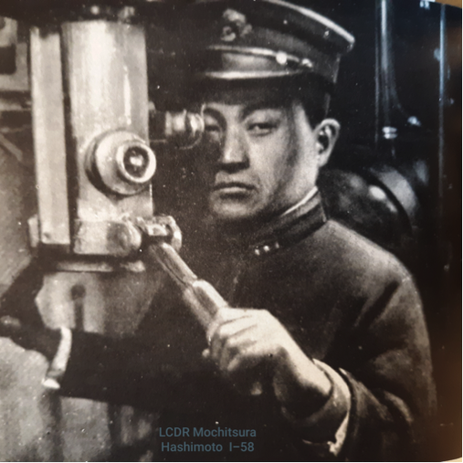
IJN Submarine I-58
An Imperial Japanese Navy Submarine (I-58) was maneuvering near “Route Peddie” during Indy’s Duty Watch Period 6.
Lieutenant Commander Mochitsura Hashimoto was the Commanding Officer on I-58.
LCDR Hashimoto is depicted here at his sub’s periscope.

Slide 60
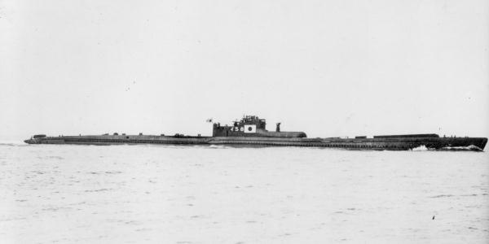
Actual photo of Commander Hashimoto’s IJN I-58 submarine

Slide 61
I-58 locates Indy
At 2226 hours (after the moon had risen), Hashimoto’s sub was still submerged, but she rose to periscope depth. Hashimoto was under the impression that visibility was too poor to search for ships using the periscope.
At 2335 hours, I-58 briefly surfaced. Hashimoto was still looking through the night periscope when the I-58’s navigator, using binoculars, shouted,
“Bearing red nine-zero degrees, a possible enemy ship.”
Hashimoto then confirmed with his own binoculars and located Indy at a distance of 10,000 meters.

Slide 62
I-58 prepares to attack Indy
I-58 re-submerged and Hashimoto initiated his plan for an attack and acquired his target using his night periscope.
He directed his crew to prepare six Type 95 torpedoes.
He also ordered two (suicide) pilots to stand ready as a possible alternative weapon in the event the torpedo attack should fail.
Kaiten

Slide 63
Kaiten Suicide Craft
An extreme offensive weaponry used on Imperial Japanese Navy (IJN) submarines was the use of a submerged torpedo that was “manned” by a suicide pilot.
Multiple Kaiten Suicide Craft were physically attached to the outer hull of a submarine and upon command could launch and the Kaiten’s suicide pilot would steer the weapon to target to make a direct hit.
While Hashimoto was optimistic that he could successfully attack his target using Type 95 Torpedoes, he nevertheless gave the order,
“Kaitens Stand By.”

Slide 64
I-58 closes in on Indy
At 2348 hours, I-58 was approximately 3,000 meters from Indy.
In the remaining minutes just prior to 2400 hours, Indy’s watch personnel for Duty Watch Period 6 (for 29 July) were relieved and their replacements were on duty.
Watch personnel for Duty Watch Period 1 (for 30 July) then visually scanned the surface and saw nothing of concern since I-58 was submerged.

Slide 65
I-58 attacks Indy
When I-58 was within 1,500 meters from Indy, Hashimoto ordered his crew to fire a spread of 6 torpedoes within the approximate time period of 2356 to 0002 hours.
At about 0002 hours, the first of two successful torpedoes hit the bow area forward of the 8” Gun Turret #I on Indy’s starboard side.
Within seconds, the second successful torpedo hit close to amidships adjacent to the 8” Gun Turret #2 also on Indy’s starboard side.
Additional multiple explosions from Indy’s internal gasoline tanks and ammunition storage areas soon followed.

Slide 66
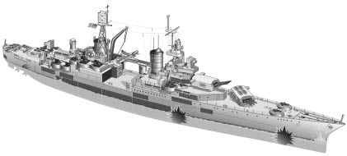
Graphic Depiction of the Torpedo Hits
2nd torpedo strikes
seconds later
1st torpedo strikes
at 0002 hrs

Slide 67
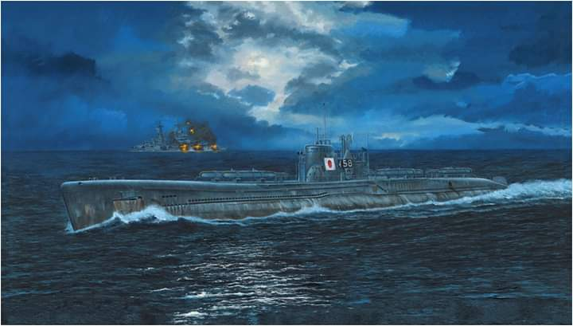
An Artistic Rendering of the Attack Scene

Slide 68
Indy suffers catastrophic damage
The first torpedo opened up most of Indy’s bow and water began rushing in as the ship continued to move forward.
With the second torpedo explosion (and ensuing internal explosions), the ship began to list, first 2 degrees, then quickly on to 10, 25, 45 and finally 90 degrees onto her starboard (right) side.
All power was lost and internal communication systems were destroyed which prevented Captain McVay from receiving updates from engine rooms below.
Damage to Radio Rooms 1 and 2 impacted the ability to confirm whether distress signals were being transmitted or not.
By word of mouth, Captain McVay passed the message
“Abandon Ship.”

Slide 69
Indy Sinks at 0015 on 30 July 1945
USS Indianapolis (CA-35) was so severely damaged that it sank about 12 minutes after the second torpedo hit.
As a result of the rapid sinking, only a few life rafts were deployed and most men had only a kapok life Jacket or an inflatable life belt. There were many men who had no life supporting equipment.
About 200 ft of Indy’s stern rose vertically out of the water as the ship descended and sunk bow first.
USS Indianapolis (CA-35) sank about midway between Guam and Leyte at approximately 0015 on 30 July 1945.

Slide 70
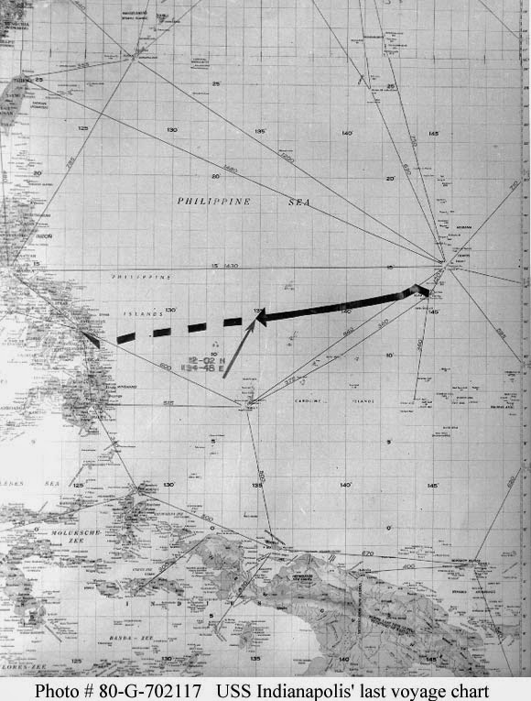
USS Indianapolis
(CA-35)
sank here after
midnight on
30 July 1945

Slide 72

Missing Men
An estimated 300 men went down with the ship.
About 100 men survived the sinking but had suffered severe and traumatic wounds sustained in the torpedo explosions. They would die within the first few hours after the sinking.
Another 475 men died in the water over the next 4 ½ days from multiple causes: dehydration, overexposure, exhaustion, intentional saltwater ingestion, hallucinatory driven attacks on fellow crew and frequent and multiple shark attacks.
Note that following rescue, dozens of bodies were identified and buried at sea by crew members serving aboard US Navy Recovery Ships, but
875 men were initially reported as
“Missing.”

Slide 74
Deceased Post-Rescue
Four (4) crew members initially survived through rescue, but were in very critical condition. Sadly, they passed away during the early hours of the Post Rescue period.
The four Deceased Post-Rescue sailors were:
Frederick E. Harrison
Ralph R. Peterson
Robert A. Russell
Robert L. Shipman

Slide 75

Pain, Suffering and Fear
Those rescued had faced many challenges:
Sun exposure in daylight hours
Temperature drops at night
Dehydration and salt water sores
Injuries sustained from onboard fires
Hypernatremia (Salt Water Poisoning)
Physical attacks from deranged shipmates
Bunker oil ingestion and eye exposure
Sharks, sharks and more sharks

Slide 76
Planes Overhead
Post sinking, survivors saw multiple planes fly over; but all were so high (and out of range) that the pilots never spotted them despite survivor efforts to send up flares.
On the second night, a U.S. Army Air Force pilot flying from Manila to Guam had reported “naval action” around 1900 on 31 July, 400+ miles east of Manila. In hind sight, it was likely that the pilot had seen flares sent up from a few of the survivor rafts.
The “naval action” was reported to Operations and Navigation at Guam. The action was dismissed under the assumption that if it was naval action, the Navy was already aware of it!
About noon on 2 August (84 hours post sinking), survivors would be discovered (by chance) by the pilot of a PV-1 Ventura plane!

Slide 77
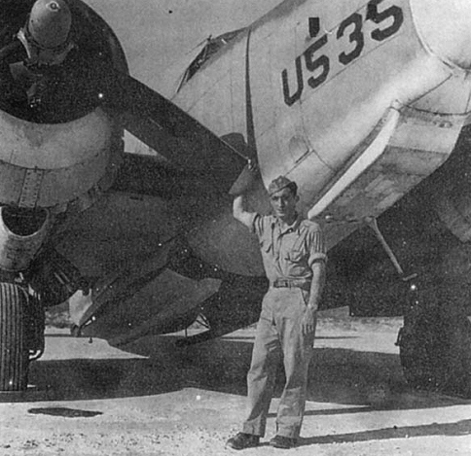
An “Angel” arrives
a PV-1 Ventura piloted by Lt Chuck Gwinn flies over
The plane’s radio antenna required service
Lt Gwinn turns over controls to co-pilot
In flight, Gwinn services the antenna
He looks thru hatch in bottom of plane
He sees an oil slick and returns to controls
He sees “Ducks on the Pond” (bodies in water)
He radios in to request rescue assistance
Survivors would label Gwinn “Our Angel”
Our Angel
PV-1 Ventura Pilot Chuck Gwinn

Slide 78
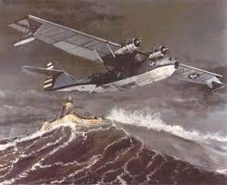
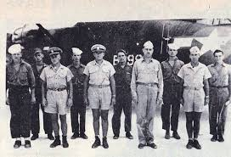
A PBY-5A arrives
a PBY-5A Catalina piloted by Lt Adrian Marks flies over
The PBY-5A was the first recovery craft to arrive on scene
Lt Marks advises home base upon arrival
Marks witnesses sharks attacking survivors
Against regulations, he lands his plane in the water
He begins to taxi his plane to pick up survivors
Mark’s crew is successful in rescuing 53 survivors
Survivors fill plane’s body with many strapped on wings
The PBY-5A was damaged and was later destroyed
PBY-5A Catalina Playmate 2
PBY-5A Catalina Crew

Slide 79
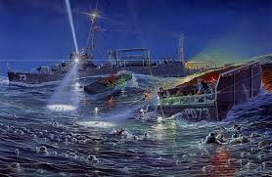
US Navy Surface Craft arrive on scene
USS Cecil Doyle
DE-368 rescues 39
USS Bassett
APD-73 rescues 151
USS Ringness
APD-100 rescues 39
USS Ralph Talbot
DD-390 rescues 24
USS Register
APD-92 rescues 12
USS Dufilho
DE-423 rescues 1
PBY-5As:
(Marks) rescues 53
(Alcorn) rescues 1
and transfers
to USS Doyle
320
rescued

Slide 80
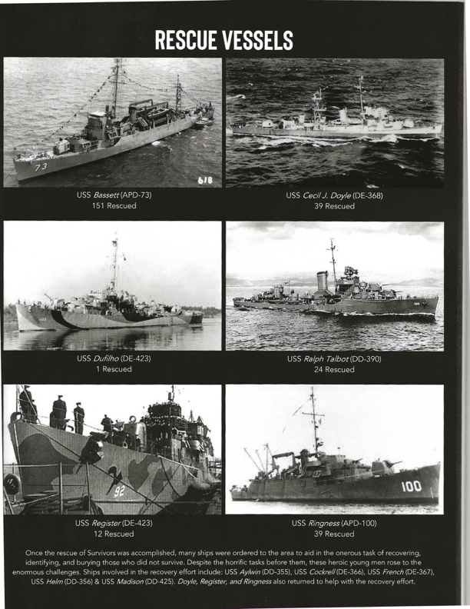

Slide 81
Survivors transported for care
The last Indy survivor was rescued at about 1300 hours on Friday, 3 August 1945 (4 ½ days or 107 hrs after Indy’s sinking).
Survivors were initially transported by various rescue ships to either Fleet Hospital #114 in Samar, Philippines or Base Hospital #20 in Peleliu, Palau.
The Samar group would later be flown to Guam Base Hospital #18.
The Peleliu group would later be transported by USS Tranquility (AH-14) to Guam Base Hospital #18.
The survivors remained under medical care for weeks.

Slide 82
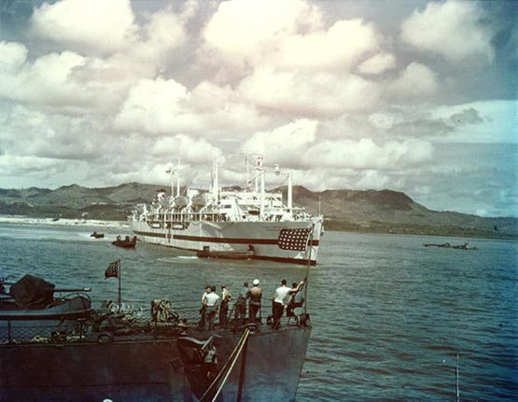
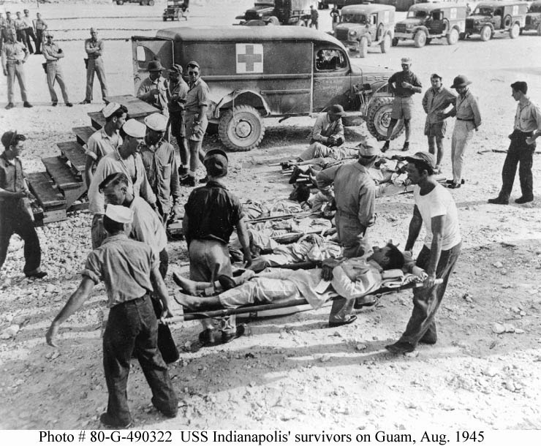
Actual photos taken Post Rescue
USS Tranquility AH-14 with Indy Survivors
All brought to Guam Base Hospital #18

Slide 83
Survivors
316* crew members survived to return home to the USA.
These survivors had spent up to 4½ days and nights in the water.
(with many suffering from flash burns, deep cuts and broken bones)
Collectively, they were members of at least seven (7) separate groups of survivors that had formed and drifted apart.
The groups were spread over approximately 25 square miles at rescue.
There were a few stray groups that were much smaller, and some with even 1-3 men.
* A cover sheet dated 8 August 1945 (with supporting documentation) was presented to the US Navy’s Court of
Inquiry that convened from 13-20 August 1945. The sheet listed 316 Survivors, 4 Dead and 876 Missing. As
previously mentioned, the 4 deceased crew members were alive, but in very critical condition at rescue. They
passed away within hours of being rescued. One man (Clarence Donner) was initially recorded as “Missing,”
but he was subsequently confirmed to have not been aboard on Indy’s Final Voyage.
In total, 879 men would not survive to return home and were recorded as “Lost At Sea” and/or “Deceased”.

Slide 84
Survivor Quotes
These actual survivor quotes “Tell It All” ...
“Never Give Up”
“I lost my home!”
“The guys I knew on the ship were all killed!”
“I never left the ship …. The ship just left me!”
“Water was everywhere yet not a drop to drink!”
“Thirst was agonizing, an inconceivable torture!”
“How could anything that big and beautiful sink?”
“This event never dies. It is always in the life of the leftover men.”
“I heard terrible screaming of men beneath me being burned alive!”

Slide 85
Japan surrenders on 15 August 1945
While still receiving medical care, the survivors learned of the Hiroshima and Nagasaki bombings (6 and 9 Aug, respectively).
They also learned of Japan’s surrender on 15 August 1945.
It was not until after 15 August 1945 that the survivors would learn the details about the contents of the Top Secret Cargo that Indy had transported and delivered to Tinian Island back on 26 July.

Slide 86
Little Boy
The contents of the Top Secret Cargo were unknown to the Captain and crew before, during and immediately after Indy’s 26 July delivery to Tinian Island.
Captain McVay had only been informed that the Top Secret Cargo must be protected at all cost and that a speedy transport of the cargo would result in a sooner end to the war.
What would eventually be disclosed and learned by the crew was that the Top Secret Cargo had contained components of “Little Boy”
(the Atomic Bomb) which was dropped on Hiroshima on 6 August as
the initial step to end the war with Japan.

Slide 87
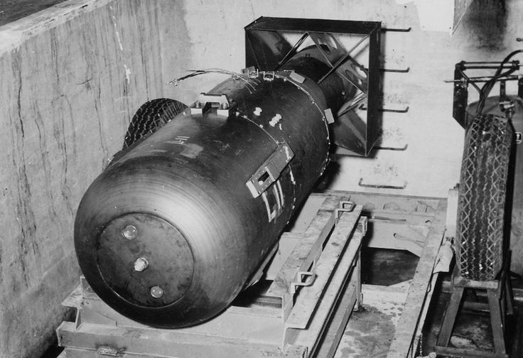
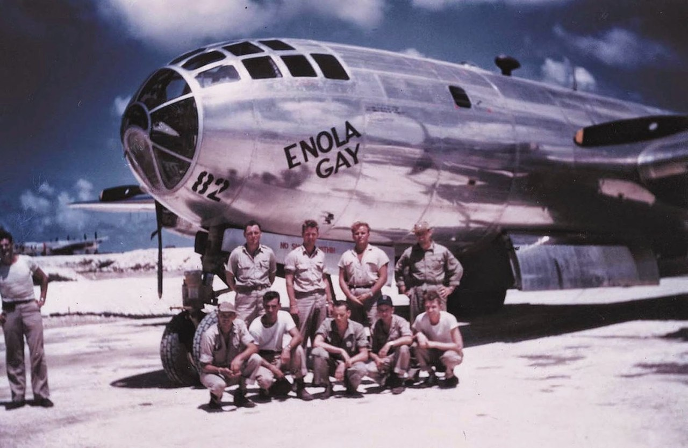
Shown below are photos of “Little Boy” and the plane “Enola Gay” and her crew that would drop the atomic bomb at Hiroshima on 6 August 1945.
Little Boy
Enola Gay

Slide 88
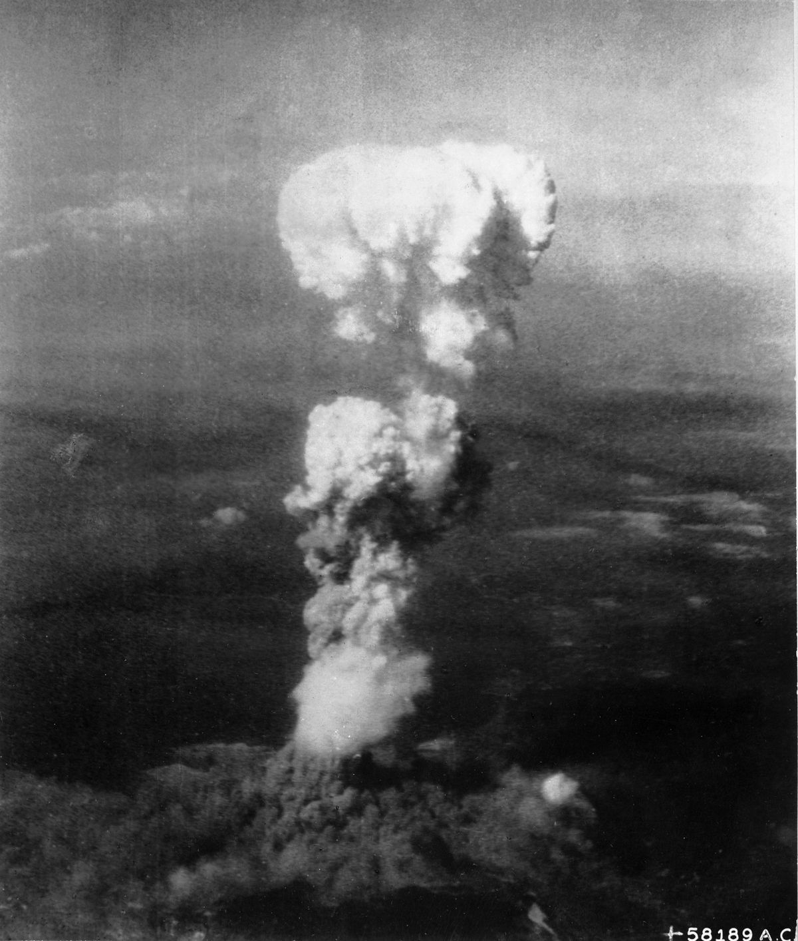
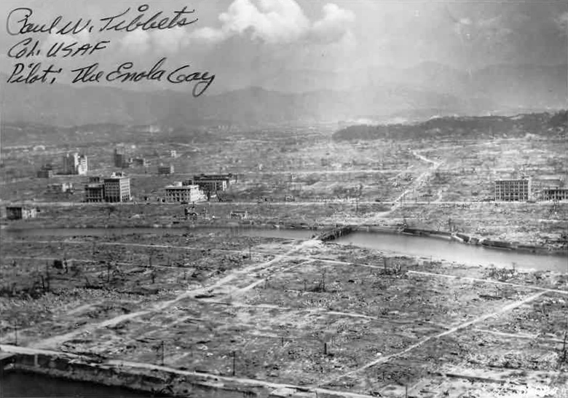
Atomic Bombs End the War
On 6 August 1945, an atomic bomb was dropped on Hiroshima.
On 9 August, a second bomb was dropped on Nagasaki.
On 15 August, Japan surrendered to end the war.

Slide 89
A Court of Inquiry
A Court of Inquiry was convened on 13-20 August 1945 in Guam.
The purpose of the inquiry was to investigate and assign responsibility as appropriate with regard to the sinking of USS Indianapolis (CA-35).
Captain McVay and selected crew members testified.
Port Authorities from Guam (ship’s departure port) and Leyte (ship’s destination port) testified.
US Navy standard procedures and responsibilities as applicable to the onboard crew and onshore support installations were also reviewed in detail.

Slide 90
Court of Inquiry – Facts and Opinions
A Court of Inquiry report begins with a “Finding of Fact”.
“Opinions” are things that the Board of Inquiry infers from the facts.
The Court of Inquiry produced a list of Forty-Six (46) Opinions.
These opinions were based on numerous assumptions about conditions, situations and personnel responsibilities both onboard and off the ship.
The Final Opinion #46 stated that:
“All personnel losses and injuries were incurred in line of duty, and not as a result of their own misconduct.”
(Note that Opinion #46 was a technical finding that simply put the injured and dead in the “combat casualty” category rather than the “accident” category. What this means is that the government will compensate them for their loss. It does not mean, however, that nobody was to blame.)

Slide 91
Court of Inquiry - Recommendations
Notwithstanding the Final Opinion, the Court of Inquiry produced a list of Eight (8) Recommendations.
Key to those recommendations was Recommendation #1 A:
A. That Captain Charles B. McVay, III, U.S. Navy, be brought to trial
by general court-martial on the following charges:
I. Culpable inefficiency in the performance of his duty.
(under Article 8, Section 10, articles for the government of the Navy)
II. Negligently endangering lives of others.
(under Article 22, articles for the government of the Navy)

Slide 92
Court of Inquiry - Conclusions
The Court of Inquiry concluded that:
Captain McVay should face trial by court-martial for not zigzagging the ship and additionally for his delay in issuing the call to “Abandon Ship.”
A letter of admonition was to be given to the Leyte Port Director for his error in not reporting that Indy had not arrived in Leyte.
Disciplinary actions were to be given to Communications Officers in Leyte.

Slide 93
The Court-Martial
The Court-Martial of Captain McVay was held in Washington, D.C. at the Washington Navy Yard during the first week of December 1945.
During the trial, the US Navy made an unprecedented decision to bring LCDR Mochitsura Hashimoto from Japan to the United States to serve as a trial witness in Captain McVay’s Court-Martial.
In his testimony, however, LCDR Hashimoto stated that a decision by Captain McVay to Zig-Zag (or not) would not have impacted his ability to successfully attack and sink USS Indianapolis (CA-35).

Slide 94
Court-Martial - Conclusions
Captain McVay was convicted of negligence in hazarding his ship by not zig-zagging.
He was acquitted on the charge of having not timely issued an “Abandon Ship” order to his crew.
The court sentenced McVay to lose 200 “numbers” toward his advancement in rank. This meant that 200 other officers would be put ahead of McVay for his promotion from captain to rear admiral.
As a result of the court martial, McVay’s career would essentially be ruined and he would never again serve in command of another ship.

Slide 95
Court Martial - Aftermath
In the years following the Court-Martial, USS Indianapolis survivors
(as well as the general public) shared a mutual feeling that Captain McVay was the “Navy’s Scapegoat.”
After meeting with fellow shipmates at Indy’s First Reunion in 1960, survivors joined together to initiate efforts aimed at securing an exoneration for Captain McVay.
An exoneration would be forthcoming, but not for decades!
Sadly, on November 6, 1968, Charles B. McVay, III committed suicide.

Slide 96
Indianapolis Reunions
USS Indianapolis (CA-35) was lost to the sea on 30 July 1945.
The memories of Indy, her crew and the roles they played during WW II will never be forgotten.
The Survivors and Lost At Sea families and friends have been keeping Indy’s story alive for future generations.
Many reunions have been held over the years and they have each served (and will continue to serve) to keep alive the legacy of
USS Indianapolis (CA-35) and her storied crew.

Slide 97
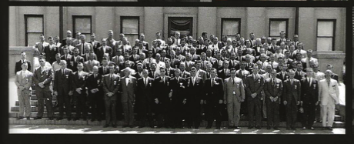
The First Reunion
The First Reunion (15th anniversary) honoring the survivors and the lost at sea’s families and friends of USS Indianapolis (CA-35) was held in Indianapolis, Indiana on July 30-31, 1960.

Slide 98
Ongoing Reunions
After breaking the ice in 1960, the tradition of holding Indy Reunions has continued over the years.
A 75th reunion in Indianapolis, IN was planned for the year 2020; but, due to the Covid-19 Pandemic, the reunion was held in a “Virtual” format and attended via Zoom computer technology.
At the time of the 75th reunion (30 July 2020), 8 of the 316 survivors were still living.
The next few slides share actual photos from a few recent reunions leading up to the 75th ………

Slide 99
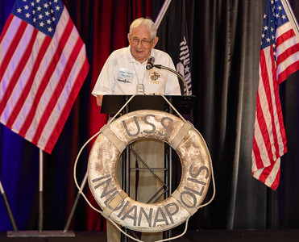
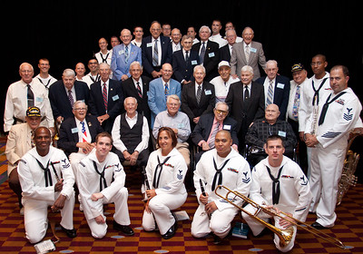
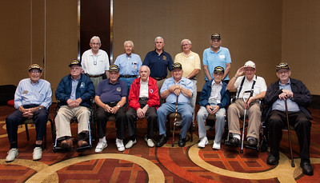
2010 Reunion - Survivors with
special guests
2013 Reunion - Survivors with
Indiana Governor Mike Pence
2019 Reunion – Survivor Edgar Harrell
2019 Reunion – A Full House at the Hyatt Hotel in Indianapolis, IN
Notes:
99

Slide 101
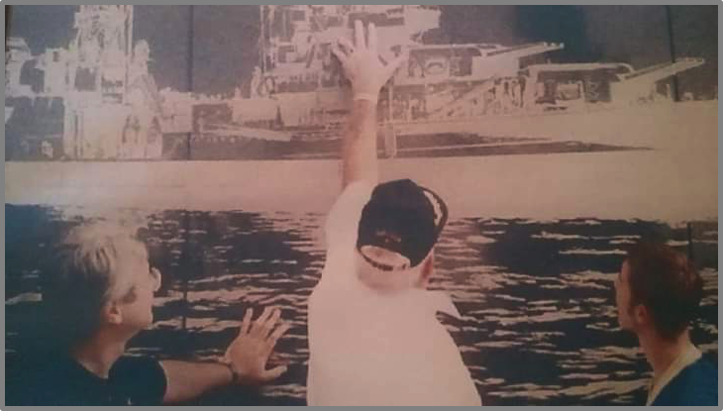
Preserving Indy’s Legacy
Sharing stories at reunions to pass on to future generations!
Jim Belcher Jr Jim Belcher Sr Jim Belcher III

Slide 102
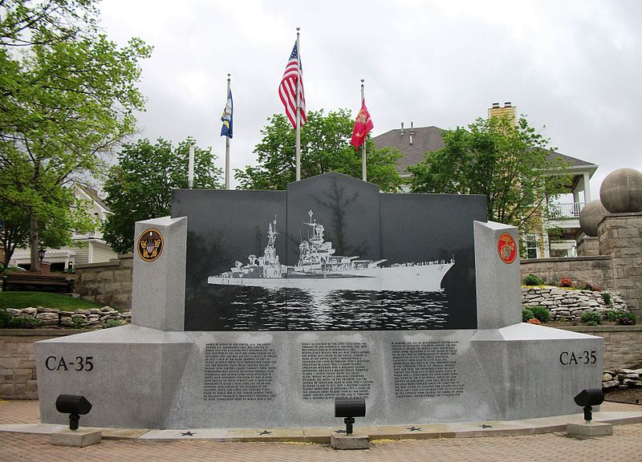
National Memorial
On 2 August 1995, (coinciding with the 50th Reunion),
USS Indianapolis (CA-35) National Memorial was dedicated
at the north end of the Canal Walk in the city of Indianapolis.

Slide 103
Exoneration of Captain McVay
In the late 1990’s, the combined efforts of Florida middle-schooler Hunter Scott, Congressman Bob Smith of New Hampshire, and Captain William Toti, skipper of the namesake submarine USS Indianapolis (SSN-697), led to Captain McVay’s Exoneration.
Even Mochitsura Hashimoto, former commander of I-58, the sub that sank the cruiser Indianapolis, played a part. In November 1999, Hashimoto wrote a letter to the U.S. Senate reiterating his long-held position that it was time for the American Navy to set aside Captain McVay’s conviction.
In 2000, a letter addressing Captain McVay was signed by President William J. Clinton. Clinton’s Secretary of the Navy, however, would not allow the exoneration to be added to McVay’s letter. In 2001, President George W. Bush’s Secretary of the Navy (Gordon England) directed U.S. Navy Captain William Toti to have the Exoneration Language entered into McVay’s Service Record.

Slide 104

“Still at Sea”
On 18 August 2017 ( just over 72 years after the sinking), USS Indianapolis (CA-35) was found by an underwater search team.
Indy is resting 18,000+ feet below the surface in the North Pacific Ocean. Its final resting place is honored and will remain recognized by the United States Navy as a sacred grave site.
The following five (5) pictures are samples of many that were taken by the Paul Allen Underwater Team & RV Petrel ……

Slide 105
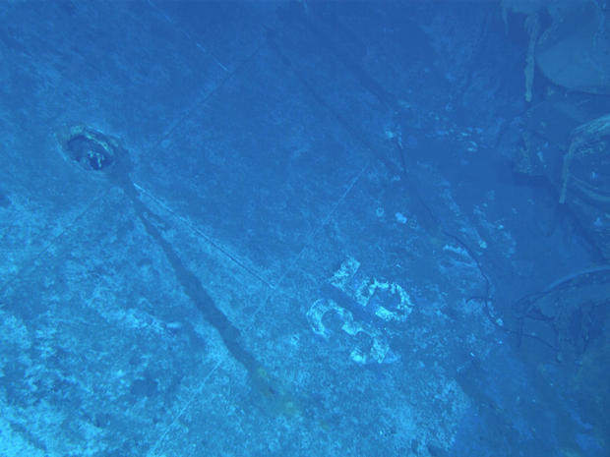
Hull number of USS Indianapolis (CA-35)
Notes:
105

Slide 106
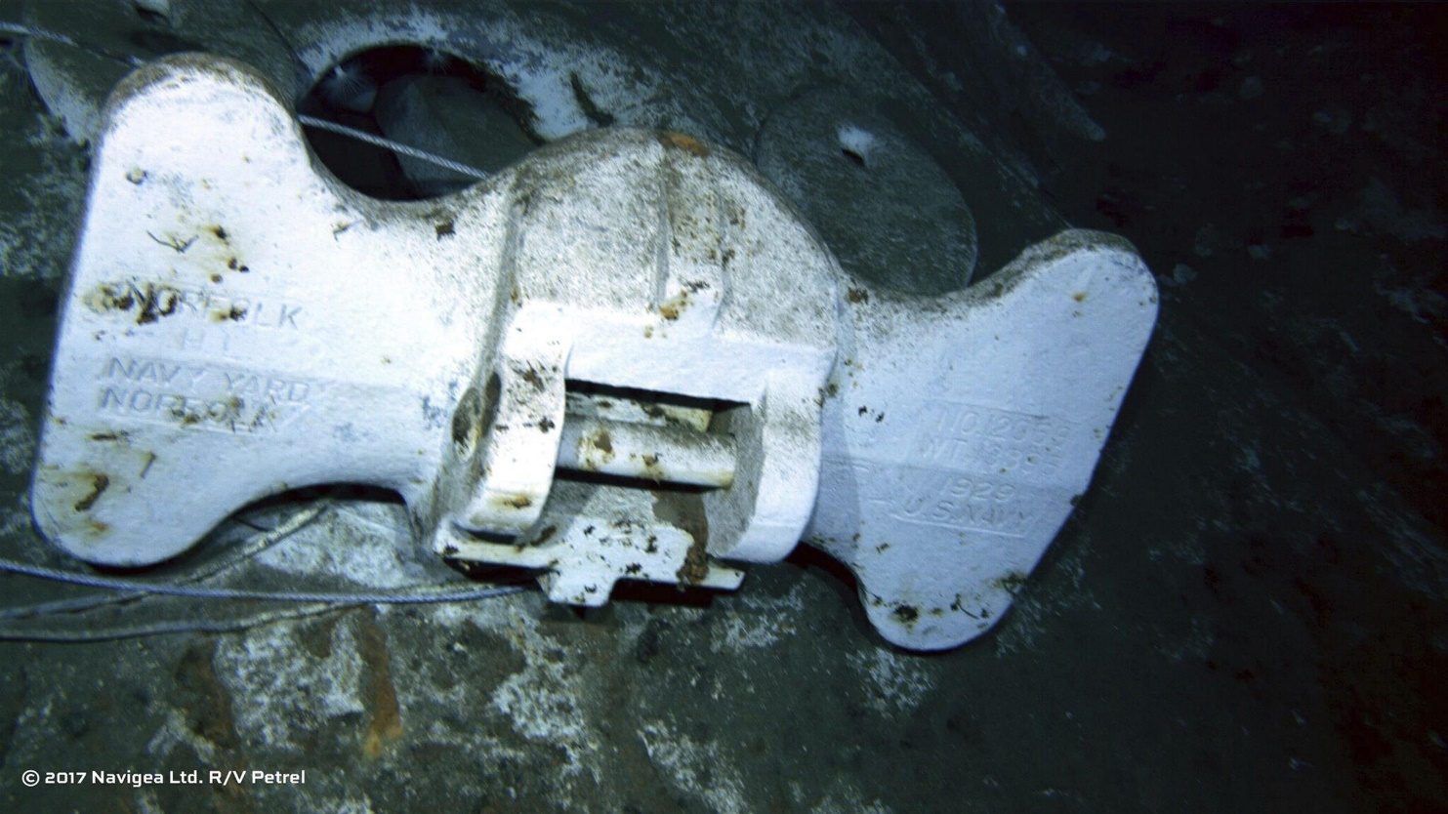
Anchor is marked “NAVY YARD NORFOLK VA”
Notes:
106

Slide 107
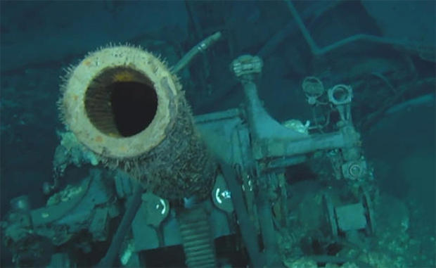
5” Gun, Rifling visible
Notes:
107

Slide 108
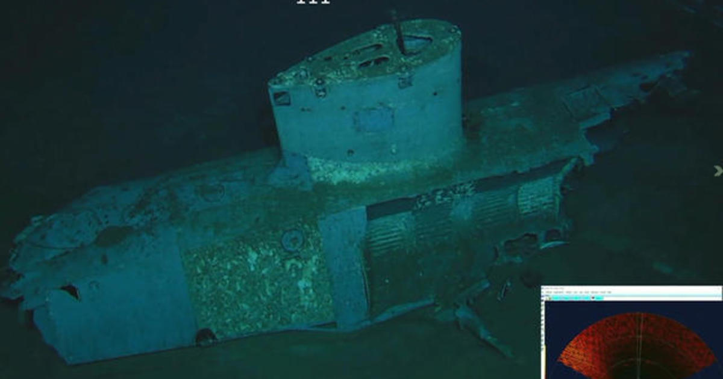
Aircraft Float
Notes:
108

Slide 109
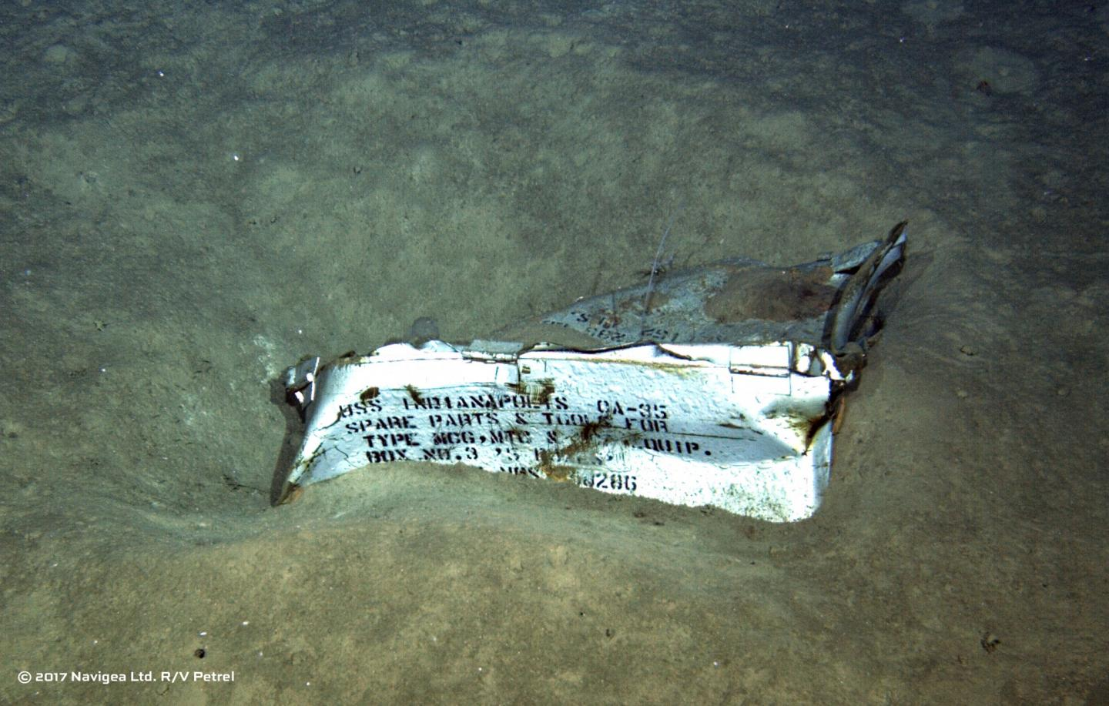
Spare Parts Box stenciled “USS INDIANAPOLIS CA-35”
Notes:
109

Slide 110
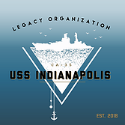
In 2018, USS Indianapolis CA-35 Legacy Organization was founded by family members and friends of Indy’s final crew.
It is a non-profit entity that was founded for the purpose of educating the public about the accomplishments and sacrifices made by this highly decorated ship and its storied crew.
The Legacy Organization is classified as a Section 501(c)(3) public charity of the Internal Revenue Code.

Slide 111
Congressional Gold Medal
On 30 July 2020 (the 75th Anniversary of the sinking of USS Indianapolis (CA-35), the United States Congress held a ceremony to commemorate the sacrifices made by Indy and her crew.
At the ceremony, a CONGRESSIONAL GOLD MEDAL was presented …..

Slide 112
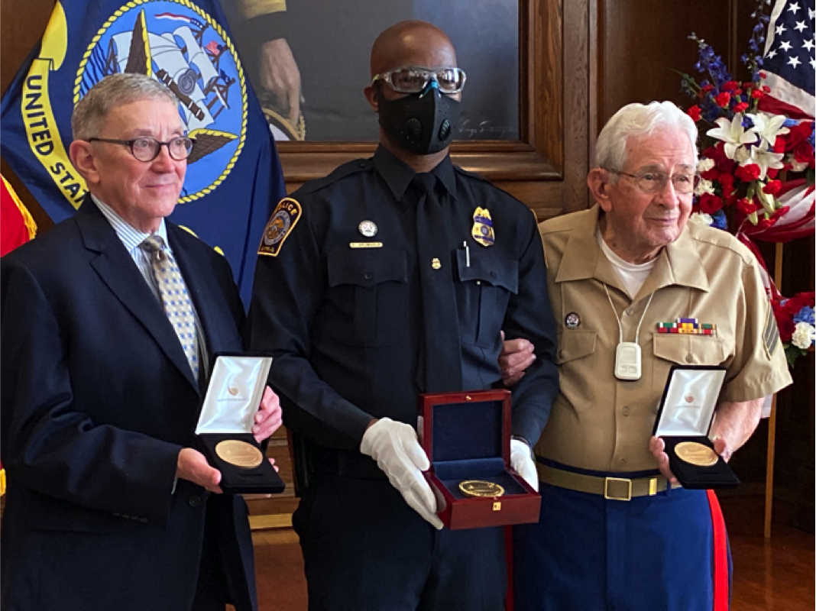
Congressional Gold Medal awarded in July 2020 to crew of USS Indianapolis (CA-35). At left, Earl Henry, Jr. represented lost-at-sea crew to include his father, LCDR Earl Henry. At right, Marine Sgt Edgar Harrell (Survivor) represented all 316 survivors. U.S. Mint Police Officer D. Drumgole holds the real Gold Medal that was later placed on display in USS Indianapolis room at Indiana War Memorial Museum in Indianapolis, IN.
(Photo courtesy of Earl Henry Archives)

Slide 113
As we near the end of this “Self-Study” Module, lets review a listing of the Highlights of what we have learned about the service of
USS Indianapolis (CA-35)

Slide 114
Highlights – USS Indianapolis (CA-35)
1930s - Ship of State for President Franklin Delano Roosevelt
- Presidential Naval Reviews for Franklin Delano Roosevelt
1941 - Flagship for Commander Scouting Force 1 eight years from 1933 to 1941
1943 - Flagship for Admiral Raymond A. Spruance from Nov 1943 thru Mar 1945
1945 - Earned Ten (10) Battle Stars in WW II from Feb 1942 to Apr 1945
- Nine crew deaths and physical damage in Okinawa Gunto on 31 March
- US Navy Speed Record from San Francisco to Pearl Harbor 16-19 July
- Transported and delivered “Little Boy” components 16-26 July
- Torpedoed and Sunk on 30 July
- 316 Survivors and 879 Lost At Sea and Deceased per official navy records

Slide 115
Highlights – USS Indianapolis (CA-35)
1945 - Court-Martial of Capt McVay in early December
1960 - 1st Survivor Reunion held in Indianapolis on 30-31 July
- Survivors begin their decades long fight for McVay Exoneration
1995 - Indy Memorial dedicated in Indianapolis on 50th Anniversary of sinking
2001 - Exoneration of Capt McVay fifty-six years after the sinking
2017 - Ocean Gravesite of Indy discovered by RV Petrel on 18 August
2018 - USS Indianapolis CA-35 Legacy Organization was founded
2020 - Congressional Gold Medal awarded at 75th Anniversary on 30 July

Slide 116
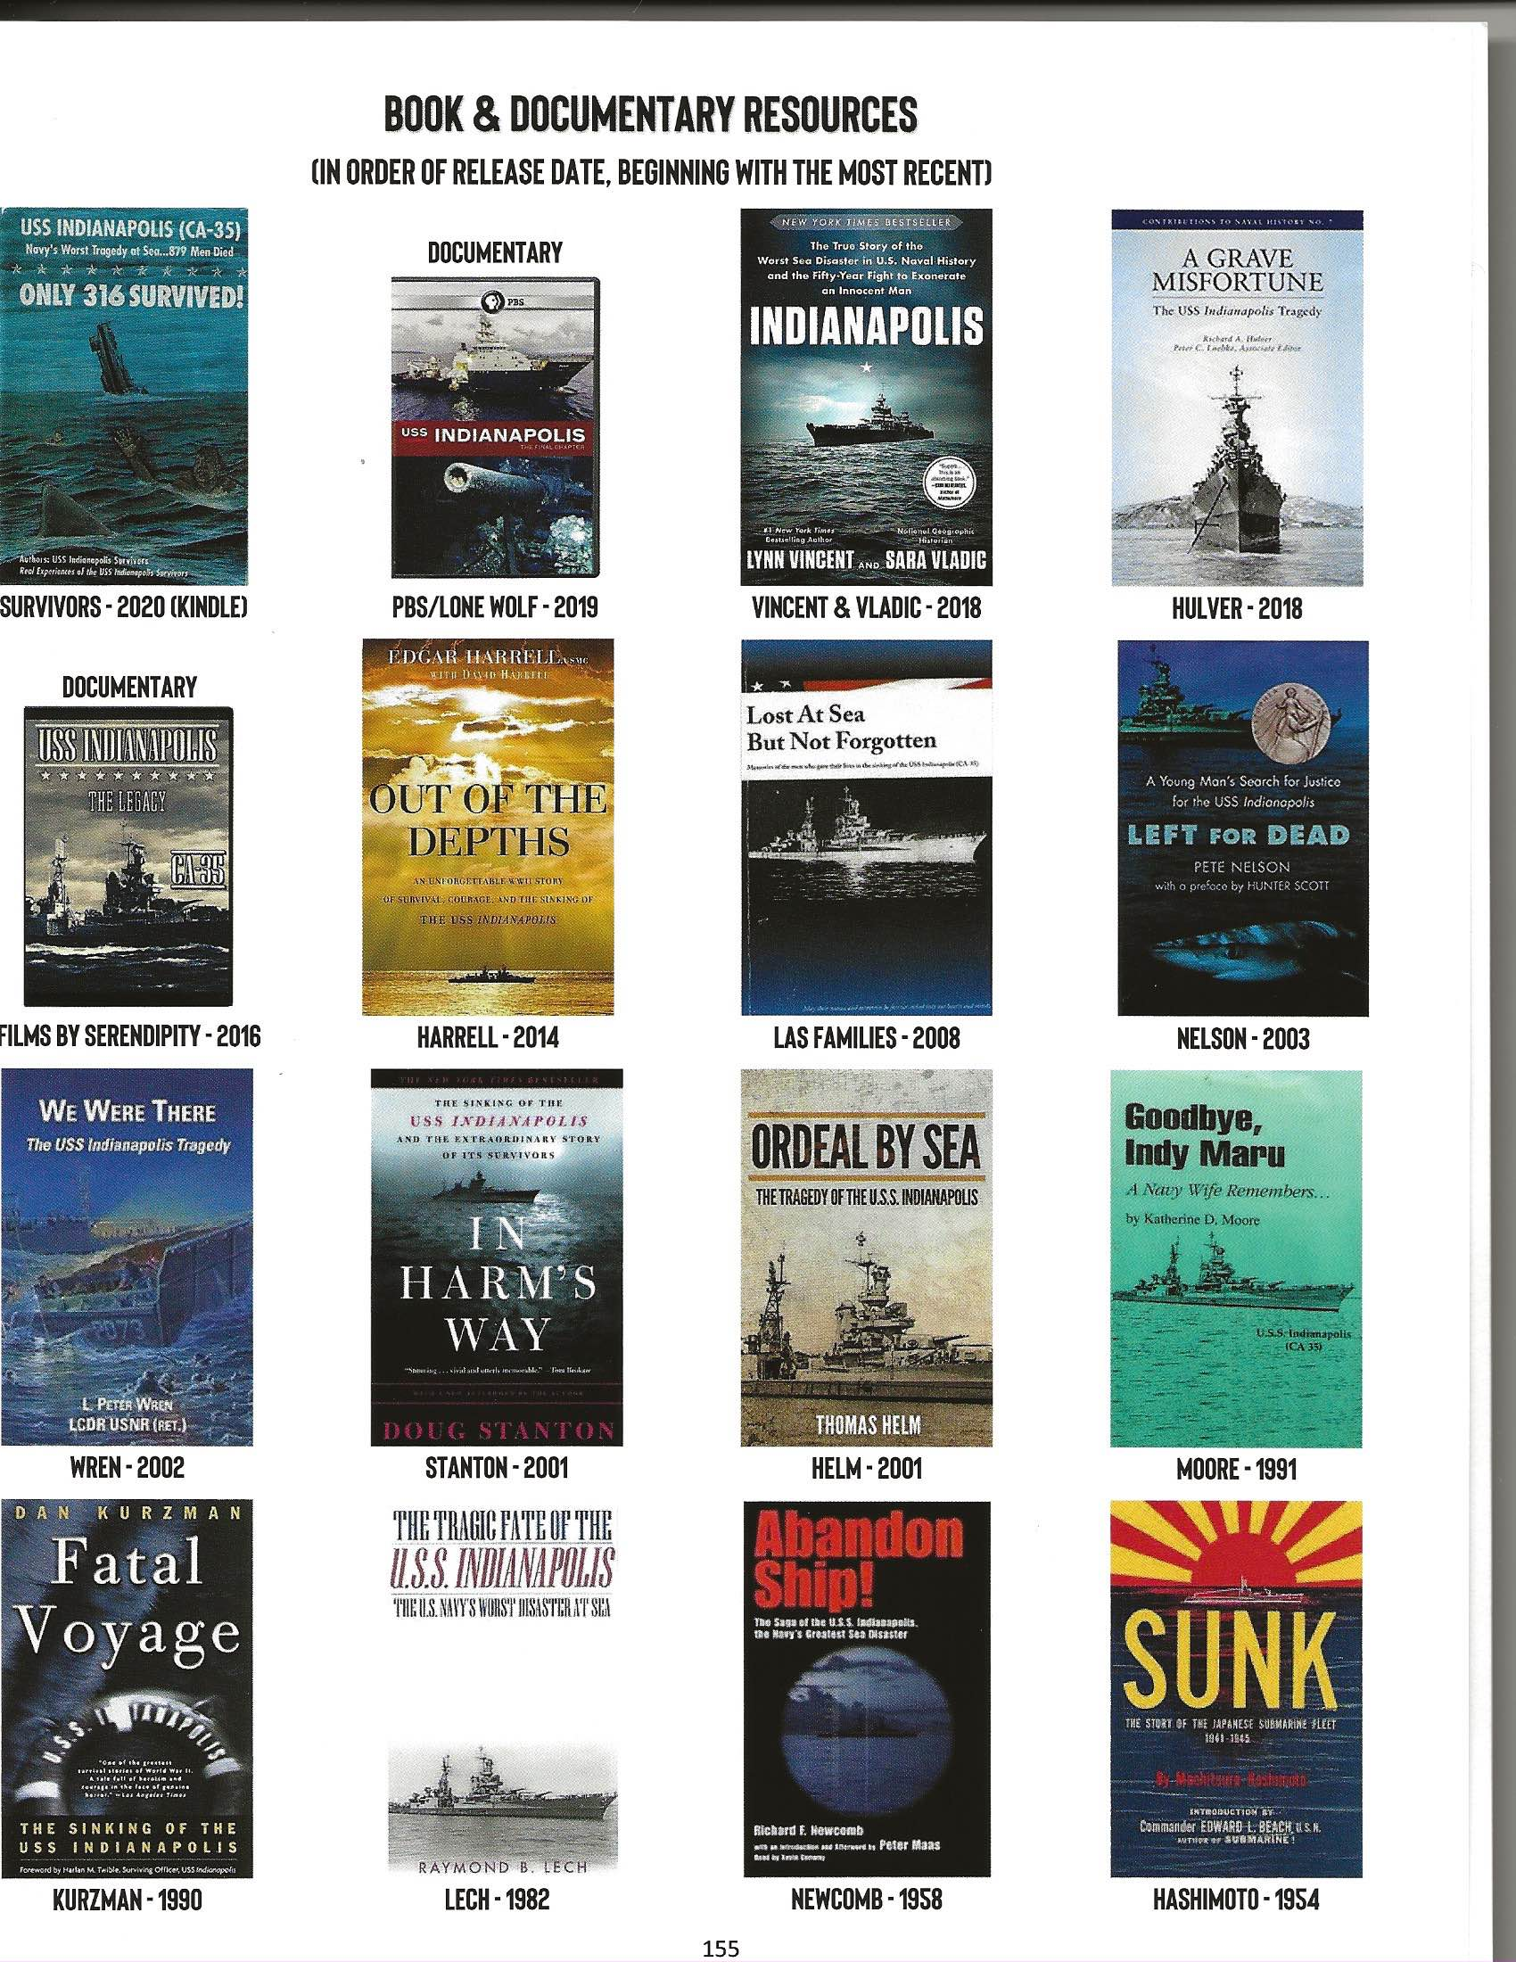
Over the years, Multiple Books & Movies have told Indy’s story!

Slide 117
The next Three Slides document the “Photo Credit” information for each of the photographs that were used in this learning module!

Slide 118
Slide 1 USS Indianapolis CA-35 off of Hawaii. Carl Mydans, Life Magazine 1940.
Slide 7 Franklin Delano Roosevelt, 1900. Courtesy of FDR Presidential Library and Museum.
Slide 9 Franklin Delano Roosevelt, 1913. Dutchess County Historical Society.
Slide 10 Franklin Delano Roosevelt. FDR Presidential Library & Museum – CT 09-109(1)
Slide 12 USS Indianapolis during naval review, 1934. U.S. Naval Historical Center.
Slides 15 and 16 Indianapolis off Mare Island, 10 July 1945 . Bureau of Ships Collection, U.S. National Archives.
Slide 39 A USS Indianapoliis (CA-35) by ship’s photographer Alfred Sedivi. BUSHIPS War Damage Reports, RG 19, Boxes 30-31, NARA II, College Park, MD. Declassified, Authority
(NND960035)
Slide 39 B Obituary of Earl Procai. Indianapolis: The True Story of the Worst Sea Disaster in U.S. Naval History and the Fifty-year Fight to Exonerate an Innocent Man. By Lynn Vincent
& Sara Vladic. Simon and Schuster 2018.
Slides 40 A B C D E Burial service aboard USS Indianapolis, March 31,1945. U.S. Naval Archives.
Slide 42 USS INDIANAPOLIS (CA-35) Commemorating 75 Years, 1945-2020. Sara Vladic & Jane Goodall, 2020. Page 10.
Slide 48 USS Indianapolis. Photo by Gus Buono, Ship’s Photographer for USS Pandemus (ARL-18), 27 July 1945 in Guam. (Purported to be the last photo taken of the USS
Indianapolis.)
Slide 50 Desktop Wallpapers ship Painting Art military, 1ZOOM.Net
Slide 59 INDIANAPOLIS: The True Story of the Worst Sea Disaster in U.S. Naval History and the Fifty-year Fight to Exonerate an Innocent Man. By Lynn Vincent & Sara Vladic. Simon
and Schuster 2018
Slide 60 I-58 during trials in 1944. Photo available at Wikipedia
Slide 66 Illustration of USS Indianapolis’ torpedo damage. This Day in History, History.com.
Slide 67 IJN Submarine Illustration, artist unknown. .
Slide 70 Indianapolis’s intended route from Guam to the Philippines. A chart of the Western Pacific, U.S. Navy/National Archives.
Slide 77 Lt. Chuck Gwinn. U.S. Naval Archives.

Slide 119
Slide 78 A and B PBY5-A Catalina Illustration, artist unknown. Photo of PBY5-A Catalina crew, U.S. Naval Archives.
Slide 79 Cover art: We Were There by L. Peter Wren, 2002. Illustrator unknown.
Slide 80 USS INDIANAPOLIS (CA-35) Commemorating 75 Years, 1945-2020. Sara Vladic & Jane Goodall, 2020.
Slide 82 A USS Tranquility (AH-14) at Guam with USS Indianapolis (CA-35) survivors, 8 August 1945. U.S. Naval Archives.
Slide 82 B USS Indianapolis survivors transported to Guam naval hospital, August 1945. National Archives.
Slide 87 A The atomic bomb dubbed “Little Boy.” Public domain.
Slide 87 B Enola Gay and Crew. National Archives.
Slide 88 A Photograph of Hiroshima bomb on impact, photographed by personnel aboard the Enola Gay.
Slide 88 B Photograph of Hiroshima in the aftermath of the bombing. en.wikipedia.org
Slide 97 USS INDIANAPOLIS (CA-35) Commemorating 75 Years, 1945-2020. Sara Vladic & Jane Goodall, 2020.
Slide 99 A Survivors and Sailors in uniform, fritzinger.smugmug.com, 2010
Slide 99 B Survivor Edgar Harrell, fritzinger.smugmug.com 2019
Slide 99 C Survivors and Indiana Governor Mike Pence, fritzinger.smugmug.com, 2013
Slide 99 D A Full House at the Hyatt Hotel in Indianapolis, fritzinger smugmug.com 2019
Slide 100 Photograph of Desmond Doss, Jr / Atsuko Iida Pak / Jim Belcher, Jr.. Courtesy of Jim Belcher.
Slide 101 Three generations of the Belcher family at the USS Indianapolis Memorial on Canal Walk, Indianapolis, Indiana. Courtesy of Jim Belcher.
Slide 102 USS Indianapolis Memorial, Canal Walk, Indianapolis, Indiana. Wikipedia.

Slide 120
Slide 104 Indianapolis off Mare Island, 10 July 1945. Bureau of Ships Collection, National Archives.
Slide 105 USS Indianapolis wreck site, hull number, at the bottom of the Philippine Sea. Photo Courtesy of Vulcan, Inc.
Slide 106 USS Indianapolis wreck site, anchor, at the bottom of the Philippine Sea. Photo Courtesy of Vulcan, Inc.
Slide 107 USS Indianapolis wreck site, gun mount, at the bottom of the Philippine Sea. Photo Courtesy of Vulcan, Inc.
Slide 108 USS Indianapolis wreck site, at the bottom of the Philippine Sea. Photo Courtesy of Vulcan, Inc.
Slide 109 USS Indianapolis wreck site, spare parts box, at the bottom of the Philippine Sea. Photo Courtesy of Vulcan, Inc.
Slide 112 A Congressional Gold Medal description. U.S. Mint.
Slide 112 B Congressional Gold Medal Ceremony. Photo courtesy of Earl Henry, Jr.
Slide 116 USS Indianapolis in popular culture. USS INDIANAPOLIS (CA-35) Commemorating 75 Years, 1945-2020. Sara Vladic & Jane Goodall, 2020.

Slide 121
THANK YOU
USS Indianapolis CA-35 Legacy Organization appreciates the time you’ve spent learning about Indy’s legendary story.
We encourage you to spread the word and share what you have learned here about this storied ship and the 1,195 who sailed on its last voyage.
The sacrifices of all of our military servicemen and women are important for all Americans to remember, honor and cherish.
Our freedoms have been bought and paid for by our brave veterans.
For more information about Indy and its Legacy Organization, please visit our website at:
www.ussindianapolis.com

